Slide 1

Comprehensive Stock Market Analysis: Reliance, Adani, and TCS – Insights Powered by Angel One

Slide 2
1. Introduction 2. Objective 3. Data Gathering 4. Insight 5. Conclusion
Agenda

Slide 3


Introduction
Angel One (formerly Angel Broking) is a leading Indian stockbroking and wealth management firm, offering a range of services including equity, derivatives, commodities, and currency trading, as well as mutual funds, portfolio management, and investment advisory. Known for its affordable brokerage rates and user-friendly platforms like the Angel One app and ARQ Prime, it simplifies trading and investment for beginners and advanced trader
Welcome to Angel One's Stock Performance Dashboard, where we provide you with real-time insights into stock performance and market trends to help you make informed investment decisions

Slide 4


Key Indicators to Watch
High
Low
Close
Open
Volume

Slide 5

Objective
To Provide Data-Driven Insights: Offer a comprehensive view of stock performance metrics, allowing you to analyze key trends across various timeframes and make strategic decisions.
To Simplify Stock Evaluation: Present essential data in an easy-to-understand format, enabling you to track stock performance quickly.
To Forecast Market Movements: Use predictive insights, like close price forecasting, to help anticipate market behavior.
To Compare Stock Performance: Compare trading volume, highs/lows, and price fluctuations across different stocks and time periods for a clearer market picture.

Slide 6

Data Gathering
Sources of Data:
National Stock Exchange (NSE) internal trading data, which includes daily stock prices, volumes, 52-week highs and lows, and trades.
Market data from NSE sources and exchange data on stock trading.

Slide 7

Insights
Volume Trends by Stock Name: Our volume analysis lets you compare the trading volume of different stocks like Reliance, Adani, and TCS, highlighting the most traded stocks and market interest.
52-Week High and Low Performance: This gives an overview of each stock's highest and lowest price levels in the last year, helping identify potential support and resistance zones.
Monthly Trading Volume: The volume trend over the months indicates when stocks are most actively traded, offering insights into seasonal market fluctuations and investment opportunities.
Close Price Forecasting: The close price forecasting provides predictive insights on daily stock price movements, helping to plan better for buying or selling decisions based on anticipated market trends.

Slide 8
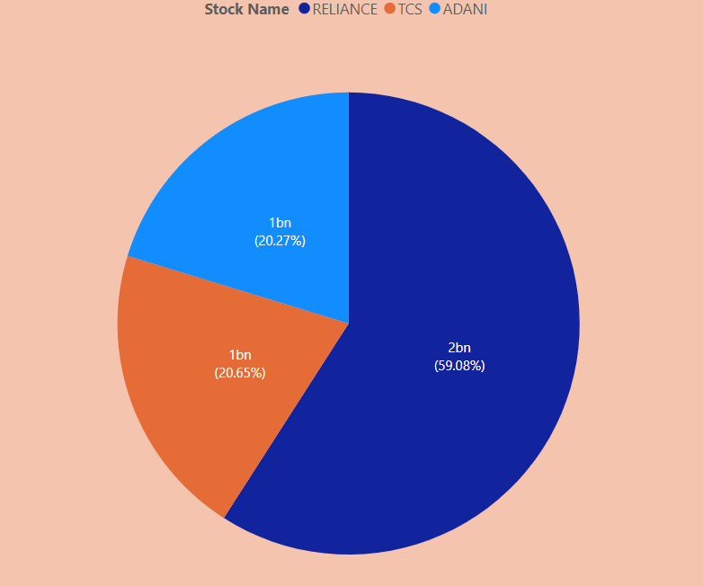
Volume Trends by Stock Name
Reliance consistently shows the highest trading volumes, indicating strong investor interest, while Adani and TCS follow closely.

Slide 9
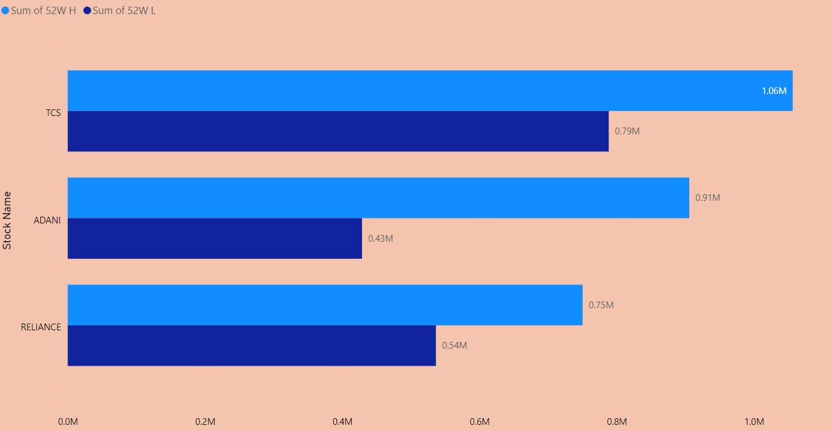
52-Week High and Low Performance
This gives an overview of each stock's highest and lowest price levels in the last year, helping identify potential support and resistance zones.

Slide 10
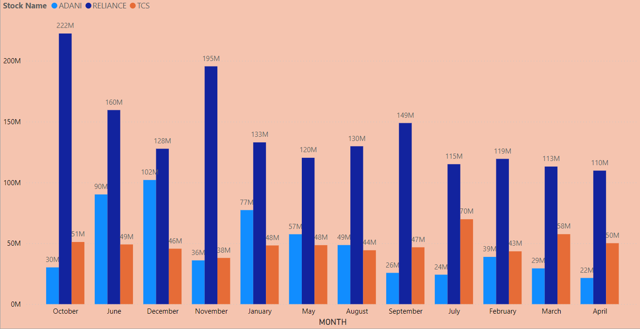
Monthly Trading Volume
The volume trend over the months indicates when stocks are most actively traded, offering insights into seasonal market fluctuations and investment opportunities.

Slide 11
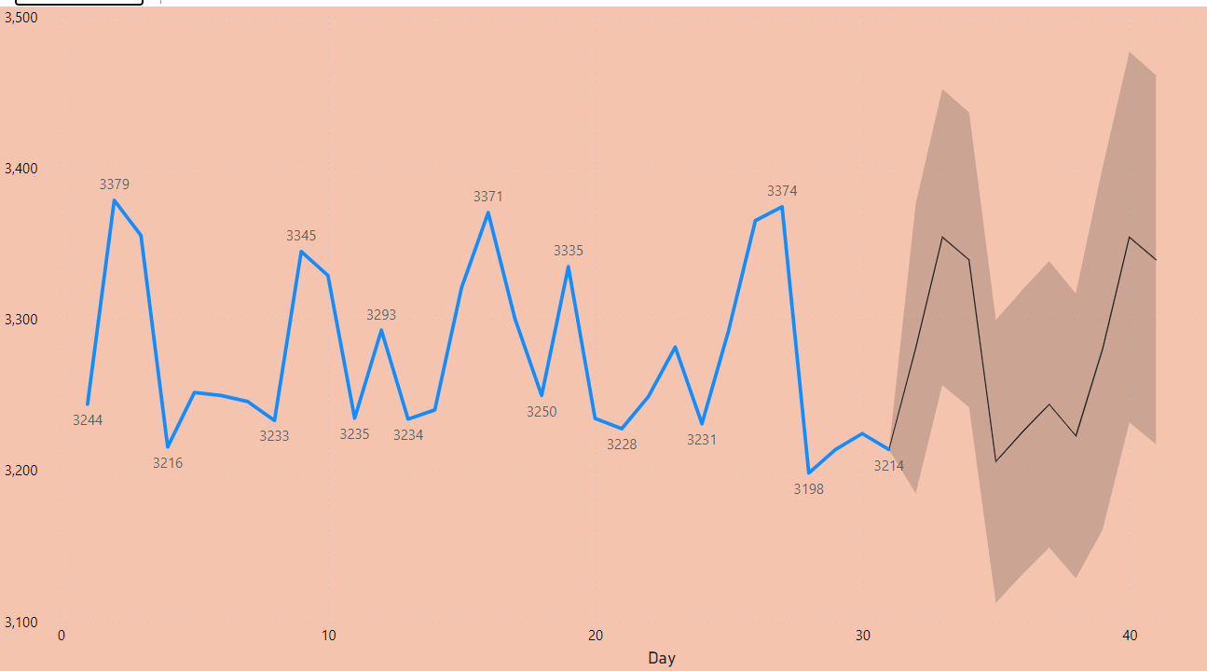
Close Price Forecasting
The close price forecasting provides predictive insights on daily stock price movements, helping to plan better for buying or selling decisions based on anticipated market trends for next 30 Days.

Slide 12

Conclusion
In conclusion, navigating the bull and bear markets requires a combination of analysis, strategy, and patience. Leverage this data to identify opportunities and risks, optimize your portfolio, and stay ahead in the market, enhance your investment journey.

Slide 13


Thanks!
Do you have any questions? sahilmani2356@gmail.com.com
+91 6263007317
Angleone.com

